Slide 1

AI DETECTION OF FAKE PROFILES ON SOCIAL MEDIA
AI Detection of Fake Profiles on Social Media
Kartik Sayal (2231089)
Pravleen Kaur (2231103)
Ramneek Kaur (2231107)
B.Tech AIML 6th semester
B.Tech AIML 6Th semester

Slide 2


Introduction
THE PROBLEM-
Over 4.9 billion social media users globally.
Fake profiles are used for-
Spamming
Mis-information
LIMITATIONS-
Manual reporting is slow.
Rule based filters are easy to bypass.
Can’t scale with millions of profiles.
OUR SOLUTION-
An AI Based system that-
Detects fake account in real time
Learns behavioural, textual and network patterns
Uses machine learning, deep learning and NLP to improve accuracy.

Slide 3

Problem statement and objectives
PROBLEM STATEMENT-
Fake profiles threaten:
User trust and safety
Platform credibility
Public discourse and privacy
OBJECTIVES-
Builds a detection model using ML.
Extract key features from user profiles
Evaluate models with accuracy, precision, recall, F-1 score.
Optimize for real time deployment.

Slide 4

METHODOLOGY
Collected data from Kaggle datasets.
Cleaned and balanced the dataset.
Extracted features like account age, post activity etc.
Build a pipeline from data input to model training.
Used NLP for sentiment and keyword analysis in text.

Slide 5
MODEL ARCHITECTURE
1.
MACHINE LEARNING MODELS-
used Logistic Regression, Random Forest, and SVM for baseline classification.
2.
DEEP LEARNING MODELS-
LSTM analyzed user text, CNN evaluated profile images, GNN explored user connection graph.
3.
HYBRID AI APPROACH-
4.
Combined ML and DL with NLP for improved accuracy and robustness.
MODEL SELECTION GOAL-
Identify the model with highest precision, recall, adaptability to evolving threats.

Slide 6
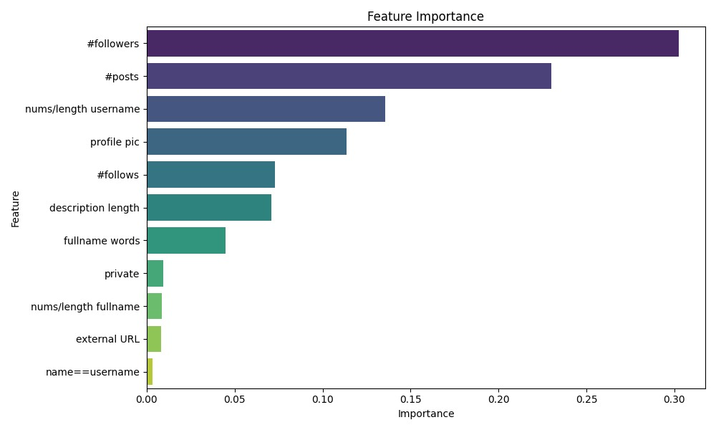
RESULTS AND ANALYSIS

Slide 7
RESULT AND ANALYSIS
MODEL PERFORMANCE
Model | Accuracy | Precision | Recall | F1-score
Logistic Regression | 85.3% | 83.7% | 81.5% | 82.6%
Random Forest | 91.2% | 90.8% | 89.5% | 90.1%
SVM | 88.7% | 87.9% | 85.6% | 86.7%
LSTM | 94.5% | 93.8% | 92.2% | 93.0%

Slide 8

FUTURE SCOPE
ENCHANCEMENTS-
Real-time detection API for social platforms
Cross-platform compatibility (e.g., Twitter, Facebook and Instagram)
Transformer models like BERT and GPT for better NLP
Use Graph Neural Networks (GNNs) to detect coordinated botnets
ETHICAL & PRIVACY FOCUS-
Deploy privacy-preserving AI models
Ensure user data is anonymized and secure
Transparent AI decisions using Explainable AI (XAI) tools

Slide 9

Thank You
PRESENTED BY-
Kartik Sayal (2231089)
Pravleen Kaur (2231103)
Ramneek Kaur (2231107)
UNDER THE GUIDANCE OF-
Dr. Manjot Kaur (Professor)

